Slide 1
Using Splunk to Automatically Mitigate Threats
Jose E Hernandez
Security Specialist, Splunk

Slide 2
Disclaimer
During the course of this presentation, we may make forward looking statements regarding future events or the expected performance of the company. We caution you that such statements reflect our current expectations and estimates based on factors currently known to us and that actual events or results could differ materially. For important factors that may cause actual results to differ from those contained in our forward-looking statements, please review our filings with the SEC. The forward-looking statements made in the this presentation are being made as of the time and date of its live presentation. If reviewed after its live presentation, this presentation may not contain current or accurate information. We do not assume any obligation to update any forward looking statements we may make. In addition, any information about our roadmap outlines our general product direction and is subject to change at any time without notice. It is for informational purposes only and shall not, be incorporated into any contract or other commitment. Splunk undertakes no obligation either to develop the features or functionality described or to include any such feature or functionality in a future release.

Slide 3
Agenda
Intro
The Framework
Attack Example #1 (The Known)
Attack Example #2 (The Unknown)
Prevention
Questions
Notes:
5 Items max
Equate section dividers

Slide 4
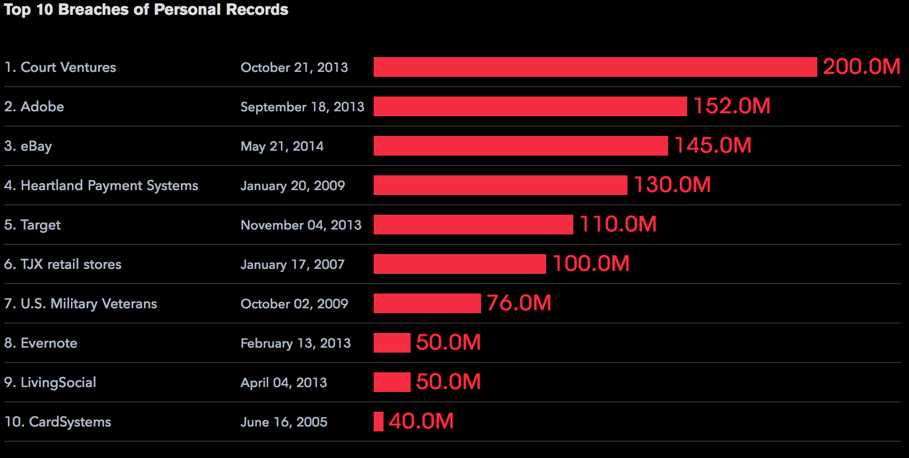
http://www.bloomberg.com/infographics/2014-08-21/top-data-breaches.html
Notes:
Say this is the bloomberg report

Slide 5
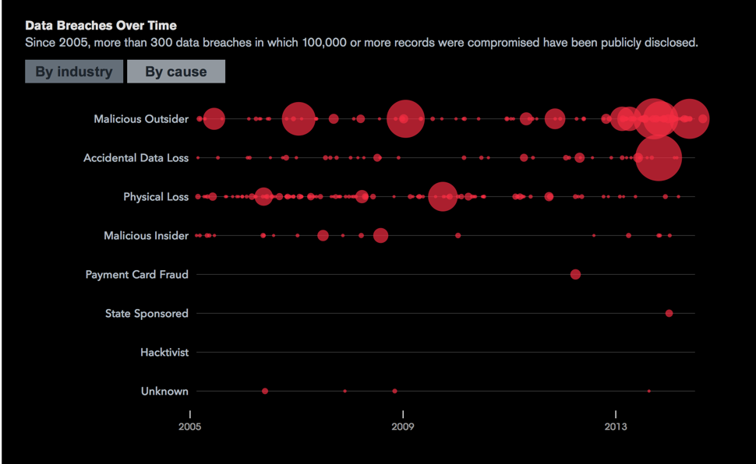
http://www.bloomberg.com/infographics/2014-08-21/top-data-breaches.html

Slide 6
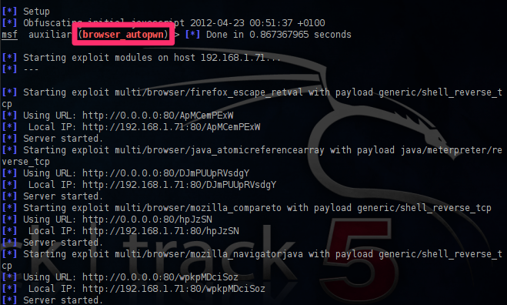
Red Team has Auto PWN Where is our Auto Mitigate?
http://pentestlab.wordpress.com/2012/04/23/metasploit-browser-autopwn/

Slide 7
Intro
Intro self (This slide does not need to exist in final version)

Slide 8

Auto Mitigating Attacks with Splunk App for Enterprise Security
Notes:
Talk about the goals of the talk
Goal: Prove that we can close the loop with Splunk
Introduce Mitigation with Splunk
Challenges:
Endpoint Threat Detection Using Splunk
Mitigation Capabilities
Lack of Windows Knowledge..

Slide 9

Auto-mitigation is not Heresy!
Is an accepted business risk
Notes:
disarm naysayers of auto Mitigation
Your attacker is using automated tools, lets turn the tables, I don’t know about you but I am tired.
Do you use spam filter, do you have an IPS in your organization..well then you are already using automitication

Slide 10
Framework

Slide 11





















Mitigation Framework
SA-Mitigation
SA-Mitigation-Endpoint
Web Services
Desktops
Packaged Applications
Networks
Real-time Machine Data
Security
Custom
Applications
RFID
Servers
Asset
& CMDB
Employee
Info
Threat
Intelligence
Applications
Data
Stores
Online Services
Databases
Notes:
Splunk and ES

Slide 12




SA-Mitigation
Creates Events
Sends a Custom Block Command
Mitigation Correlation Searches
Master Mitigation Searches
Notable
Index
Pulls Events to Block

Slide 13
SA-Mitigation
Creates Events
Sends a Custom Block Command
Mitigation Correlation Searches
Master Mitigation Searches
Notable
Index
Pulls Events to Block
| tstats `summariesonly` count from datamodel=Intrusion_Detection where earliest=-24h@h latest=+0s (IDS_Attacks.severity=critical OR IDS_Attacks.severity=high IDS_Attacks.src!=0.0.0.0 IDS_Attacks.src!="00:*") by IDS_Attacks.src,IDS_Attacks.dest,sourcetype,host | rename IDS_Attacks.src AS src | regex src="^\d{1,3}\.\d{1,3}\.\d{1,3}\.\d{1,3}$" | rename IDS_Attacks.dest AS dest | rename sourcetype as orig_sourcetype | rename host as orig_host | table orig_sourcetype,orig_host,dest,src,count | sort - count
Notes:
High level explanation why we are showing a corellation search

Slide 14
SA-Mitigation
Creates Events
Sends a Custom Block Command
Mitigation Correlation Searches
Master Mitigation Searches
Notable Index
Pulls Events to Block
index=notable source="Network - Mitigation*"
| eval id=splunk_server."@@".index."@@".md5(_time._raw)
| rename dest as system
| table id,orig_sourcetype,orig_host,src,system
| collect index=mitigation addtime=true marker="type=network,status=submitted,action=block”
| blocknetwork action=block device=10.0.0.1 vsys=vsys1 group=BADACTORS
Notes:
Mention that we have decoupled detection from action. One does not mess with the other.

Slide 15

SA-Mitigation-Endpoint
Endpoint Host
| blockendpoint pid=12345 system=test
Splunk ES SH
SA-Mitigation
Splunk Forwarder
SA-Mitigation-Endpoint

Slide 16
SA-LWF-Mitigation
Endpoint Host
| blockendpoint pid=12345 system=test
Splunk ES SH
adds pid 12345 process_queue lookup
SA-Mitigation
Splunk Forwarder
SA-Mitigation-Endpoint

Slide 17

SA-LWF-Mitigation
Endpoint Host
| blockendpoint pid=12345 system=test
Splunk ES SH
adds pid 12345 process_queue lookup
SA-Mitigation
Splunk Forwarder
Savedsearch:
queue_manager_nix runs 5/* runs block cmd
SA-Mitigation-Endpoint
Splunk Indexer
Sends results in default/proc_mitigator.log

Slide 18

Close The Loop
Visibility
Prevention
Analysis
Mitigation
Before The Loop Closes You!
Notes:
Is all about closing the loop

Slide 19
Attack Example #1 The Known

Slide 20

Notes:
First Example of Auto Mitigation Applied
NEED MORE POWERFUL IMAGE

Slide 21

Attack Scenario #1
IDS Alerts
Layer 7 FW
Attack
IDS Event to a Critical Server

Slide 22
Attack Scenario #1
IDS Alerts
Layer 7 FW
Corp Machine
Attack
Bypass FW
Block
IDS Event to a Critical Server

Slide 23
Attack Scenario #1
IDS Alerts
Layer 7 FW
Corp Machine
Attack
Bypass FW
IDS Event to a Critical Server
Block
IDS Event to a Critical Server

Slide 24
Attack Scenario #1
IDS Alerts
Layer 7 FW
Corp Machine
Attack
Bypass FW
IDS Event to a Critical Server
Block
IDS Event to a Critical Server
Notes:
Change this slide to IDS vs Layer 7 firewall

Slide 25
“Let me Show You”

Slide 26
The Known
Attack
Not Blocked
Visibility
Analyze
Audit
Attack was launched at a High Criticality Asset
Palo Alto was not set to block those specific IDS Alerts
Splunk got visibility of the attack via IDS log
Splunk analyzed the alert and with added context decided to block
Splunk decided to mitigate, sends a block message to the Palo Alto
Full history if this in the mitigation tracker
Mitigate
Notes:
Build through this slide
Have it build through
Slide of the Search
Add Resources at the end Relevant resources
Tangent === Consider adding the credential piece on a separate slide

Slide 27
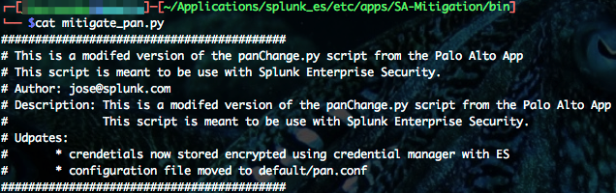
Tangent on PA App/Encrypted Store
Why We did not want to require the app with the framework
What We moved the panChange.py to our app and modified it
Also leverage the credential store to store PAN passwords

Slide 28
The Unknown

Slide 29
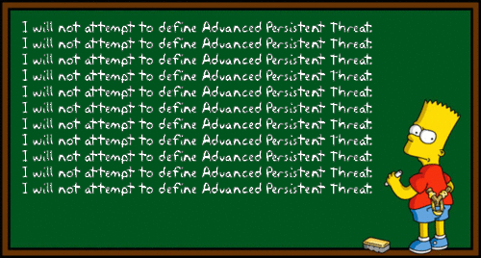
0days
Notes:
Imagine if you had a tool to catch same attack that hit all the retail customers recently with Splunk.
http://www.secureworks.com/cyber-threat-intelligence/threats/security-considerations-for-retail-networks/
And then mitigate it as well. Using registry keys

Slide 30
“Let me Show You”

Slide 31
Attack Scenario #2
Running Vulnerable Service
Layer 7 FW
exploit
exploit
Metasploit

Slide 32
Attack Scenario #2
Running Vulnerable Service
Layer 7 FW
exploit
exploit
Metasploit
Setup Persistence
Splunk Forwarder
Mitigate
Notes:
Emphasis that why we are going back

Slide 33
Attack Scenario #2
Running Vulnerable Service
Layer 7 FW
exploit
exploit
Endpoint logs
Metasploit
Setup Persistence
Splunk Forwarder
Mitigate

Slide 34
Attack Scenario #2
Running Vulnerable Service
Layer 7 FW
exploit
exploit
Endpoint logs
Metasploit
Setup Persistence
Splunk Forwarder
Registry Key with VB script
Mitigate

Slide 35
Attack Scenario #2
Running Vulnerable Service
Layer 7 FW
exploit
exploit
Endpoint logs
Metasploit
Setup Persistence
Splunk Forwarder
Registry Key with VB Script
Mitigate

Slide 36
SA-Mitigation
Gets Registry logs
Creates Events
Mitigation Correlation Searches
Master Mitigation Searches
Notable Index
Pulls Events to Block
Sends block command

Slide 37
SA-Mitigation
Gets Registry logs
Creates Events
Mitigation Correlation Searches
Master Mitigation Searches
Notable Index
Pulls Events to Block
Sends block command
sourcetype="winregistry" key_path="*\\windows\\currentversion\\run*" data="*.vbs”
| rename sourcetype as orig_sourcetype
| rename host as orig_host
| table orig_sourcetype,orig_host,dest,status,pid,process_image,key_path,data

Slide 38
SA-Mitigation
Gets Registry logs
Creates Events
Mitigation Correlation Searches
Master Mitigation Searches
Notable Index
Pulls Events to Block
Sends block command
index=notable source="Endpoint - Mitigation*" | eval id=splunk_server."@@".index."@@".md5(_time._raw) | rename dest as system | table id,orig_sourcetype,orig_host,src,system,pid,process_image,key_path,data | collect index=mitigation_summary addtime=true marker="type=endpoint,status=submitted,action=block" | blockendpoint pid=pid system=system

Slide 39
The Unknown
Determine is an attack due to registry key placed in incorrect place with vb script as parameter
Mitigated
Attacker infects vulnerable machine on the network
Bypass
Analysis
Send mitigate_proc command to endpoint to kill process and do clean up
Mitigated
The shell was closed successfully and the attacker lost its connection!

Slide 40
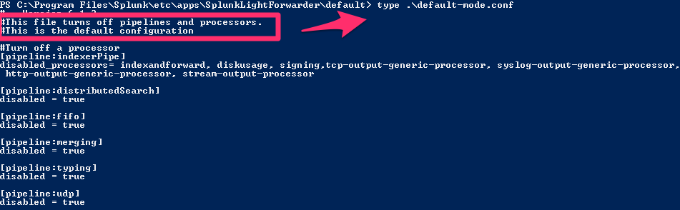
Forwarder as ETDR (Not Universal Forwarder)
What A Splunk Forwarder with Python
Why We needed Python to take action on the endpoint
How
c:\..splunk\bin\>splunk enable app SplunkLightForwarder –auth <username>:<password>
http://docs.splunk.com/Documentation/Splunk/latest/Forwarding/Deployaforwarder#Set_up_light_forwarding_with_the_CLI
Notes:
Poor mans as Endpoint Threat Detection System

Slide 41
Prevention
Prevention

Slide 42
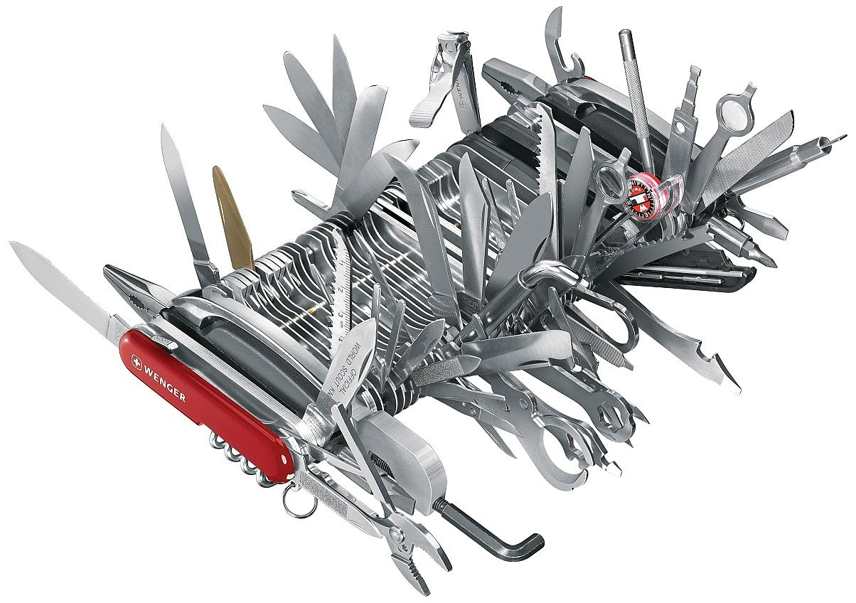
Just a Framework
Think of the Use Cases
Notes:
Threat Intel Augmentation
I just showed you two common ways to take action on the network, endpoint

Slide 43

ROI
http://www.cinemablend.com/images/reviews/5570/main.jpg

Slide 44



Find the bits at :
https://tinyurl.com/splunkautoturrent
Looking for Beta Testers
Devs:
Brian Luger bluger@splunk.com
Jose Hernandez jose@splunk.com
Monzy Merza monzy@splunk.com
Notes:
Call to Action
Make Business use case for auto mitigation

Slide 45
Questions?
Notes:
How do you Handle false positives?

